Slide 1
Memory

Slide 2
About this lecture..
In this lecture, we will study
Concepts of primary memory.
Different types of primary memory
Random access memory (RAM)
Read only memory (ROM).
Different types of RAM
Static RAM (SRAM)
Dynamic RAM (DRAM).
DRAM organization.
Design of memory subsystem using SRAM.
Design of memory subsystem using DRAM.

Slide 3
Technologies
Writeable vs. non-writeable
ROM (Read only memory)
RAM (Read write memory but known as Random Access memory)
Volatility
Does memory retain values when powered off?
ROM, NVRAM
Technology
ROM: Data masked at fabrication time
PROM: Once programmable (specialized programmers)
EPROM: Erasable and then programmable
EEPROM: Electrically (selectively) erasable
Flash: Sector oriented
RAM, Static vs. Dynamic
Dynamic: Slow but cheap. DRAM, EDORAM (Extended Data Out RAM), S(Single)DRAM, DDR(Double Data Rate)-RAM

Slide 4
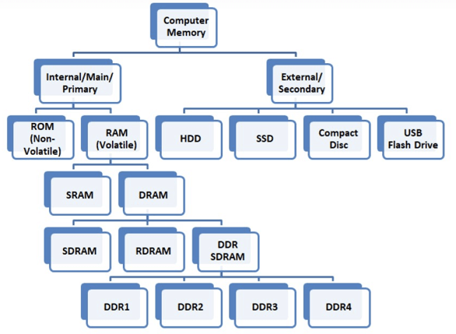
Types of RAMs
Types of RAM

Slide 5
SRAM vs DRAM
SRAM | DRAM
SRAM has lower access time, so it is faster compared to DRAM. | DRAM has higher access time, so it is slower than SRAM.
SRAM is costlier than DRAM. | DRAM costs less compared to SRAM.
SRAM requires a constant power supply, which means this type of memory which consumes more power. | DRAM offers reduced power consumption because the information is stored in the capacitor.
It is a complex internal circuitry, and it offers less storage capacity is available compared to the same physical size of a DRAM memory chip. | It is the small internal circuitry in the one-bit memory cell of DRAM. The large storage capacity is available.
SRAM has a low packaging density. | DRAM has a high packaging density.

Slide 6
Performance Comparison of RAM Types
Standard | Time in Market | Internal Rate | Bus Clock(MHZ) | Perfectch | Data rate(MT/s) | Tranfer rate(GB/s) | Voltage
SDRAM | 1993 | 100-166 | 100-166 | 1n | 100-166 | 0.8-1.3 | 3.3
DDR | 2000 | 133-200 | 133-200 | 2n | 266-400 | 2.1-3.2 | 2.5/2.6
DDR2 SDRAM | 2003 | 133-200 | 266-400 | 4n | 533-800 | 4.2-6.4 | 1.8
DDR3 | 2007 | 133-200 | 533-800 | 8n | 1066-1600 | 8.5-14.9 | 1.35/1.5
DDR 4 | 2014 | 133-200 | 1066-1600 | 8n | 2133-3200 | 17-21.3 | 1.2

Slide 7
Memory
Primary Memory keeps data and programs for execution by a computer.
Execution time depends on the program and data transfer time to and from the primary memory.
A computer generates K bit wide address for the memory.
Thus there will be 2^{K} distinct locations.

Slide 8
Memory
CPU generates address under a program control and puts them in an internal register called MAR.
MAR register output is available on the external pins of the CPU chip.
Similarly, MDR register of the processor is used to transfer data between primary memory and CPU.
Data transfer to and from memory is done using a bus known as Memory Bus.
Memory bus consists of three types of lines.
Address lines
Data lines
Control lines

Slide 9
Memory
Word-addressable Machine
A word is the memory data of size N bits.
In some computers, word is the smallest and the only addressable unit.
Words are addressed starting from 0.
Byte-addressable Machine
In some computers, Byte is the smallest addressable unit. A word consists of one byte (8 bits) for 8 bit computers, 2 bytes for 16 bit computers, 4 bytes for 32 bit computers and 8 bytes for 64 bit computers.
Bytes are addressed starting from 0.

Slide 10
Memory
Word length is the maximum number of bits that can be stored or retrieved in a single memory access.
Accessing a particular byte is done either to read or write on to the byte location.
In a byte addressable system,
Read operation fetches only the desired byte.
Write operation changes the content of only the desired byte without disturbing the other bytes in the word.

Slide 11
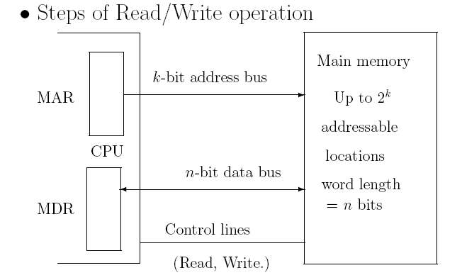
Memory
Memory Access Time: Time required to read the memory after placing a request.
Memory Cycle Time: Time required between two successive memory requests.

Slide 12
Types of Primary Memory
ROM– Read Only Memory
RAM– Random Access Memory

Slide 13
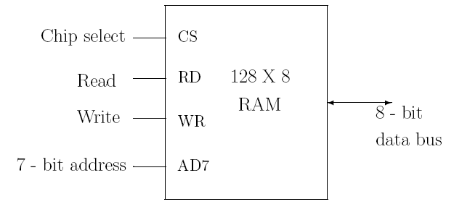
Random Access Memory
Random Access Memory (RAM) is a memory unit where data from any memory location can be read or written in a constant amount of time.
The following is the block diagram for such a memory.

Slide 14
Memory addressability
Memory is a big array of bytes
Not entire address space need to have storage attached.
Processors need to read multi-byte data structures
Short (2 bytes), int (4 bytes), double (8 bytes) etc.
Should the access be one byte at a time?
Issue of the bus interface

Slide 15
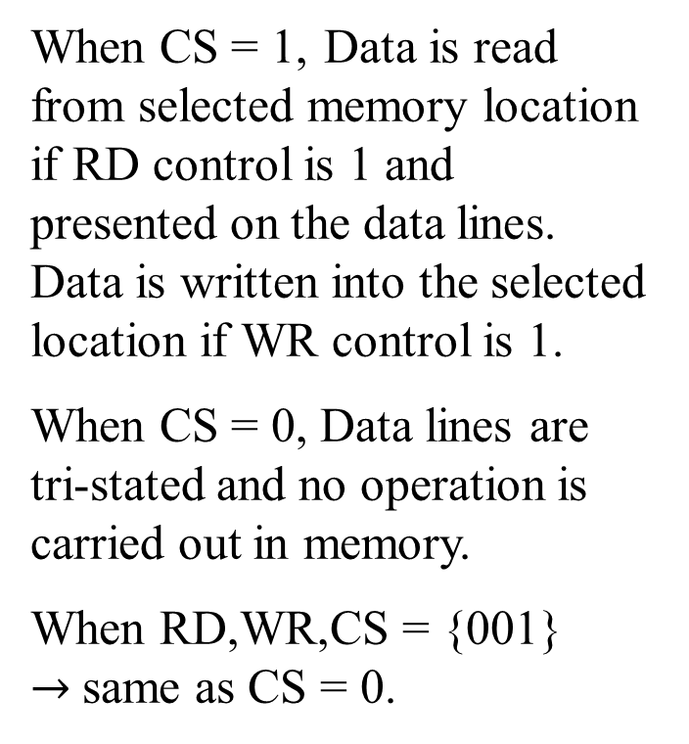
Memory Interface: Simple byte wide bus
When CS = 1, Data is read from selected memory location if RD control is 1 and presented on the data lines. Data is written into the selected location if WR control is 1.
When CS = 0, Data lines are tri-stated and no operation is carried out in memory.
When RD,WR,CS = {001} $→$same as CS = 0.
2^{n} locations
n-bit address
8-bit data
CS Control
RD, WR Controls

Slide 16
Random Access Memory
Static RAM
Dynamic RAM (DRAM)

